Slide 1
Microcomputer Systems
Course Code: CSC 2106
Course Title: Computer Organization and Architecture
Dept. of Computer Science
Faculty of Science and Technology
Lecturer No: | 1 | Week No: | 1 | Semester: | Summer 23-24
Lecturer: | Md. Faruk Abdullah Al Sohan; faruk.sohan@aiub.edu

Slide 2
Lecture Outline
1. Introduction to the architecture of microcomputers
and IBM PC
2. Peripherals and their relations to the software or Programs
3. What computer does while executing instructions
4. Advantages and disadvantages of assembly language programming
**As a microcomputer user, you already know most of these terms

Slide 3
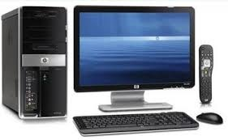
Components of Microcomputer System
SYSTEM UNIT
I/O DEVICES OR PERIPHERALS
Keyboard
Display Unit
Disk drives
INTEGRATED-CIRCUIT (IC)
Contains transistors. Digital circuits
[0’s& 1’s]
Binary Digits/ Bits: 0 or 1

Slide 4
Components of Microcomputer System
CPU:
Brain of the computers
Controls all the operations
A single chip processor (microprocessor)
MEMORY CIRCUITS : Stores information
I/O CIRCUITS : Communicate with I/O devices

Slide 5
The System Board
System Board/motherboard resides in the system unit
It contains microprocessors and memory circuits
It has expansion slots to connect additional circuit boards called add-in cards/add-in boards
I/O circuits are located in add-in cards

Slide 6
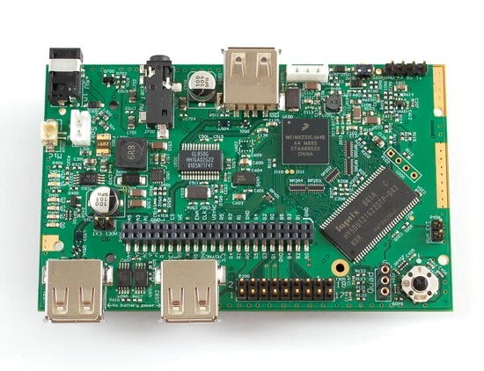
A Glimpse of Motherboard
The Components of a Microcomputer System

Slide 7
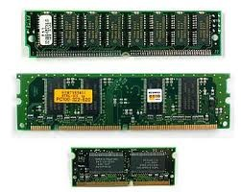
Memory
Bytes and Words:
Information processed is stored in memory
A memory circuit element can store one bit of data [i.e. 0 or 1]
Memory circuits are organized as a group of 8 bits of data
8 bits of string = 1 Byte
Memory bytes are known as address( i.e. street address of a house).

Slide 8
Address Vs Contents
The stored data in a memory byte are called contents/value.
Address | Contents
The address of a memory byte is FIXED and different from other addresses( unique). | Contents are NOT unique as they deal with current data.
The number of bits in an address depend on the processor [ i.e. Intel 8086 = 20-bit & Intel 80286=24-bit ] | Contents of memory byte are always 8 bits

Slide 9
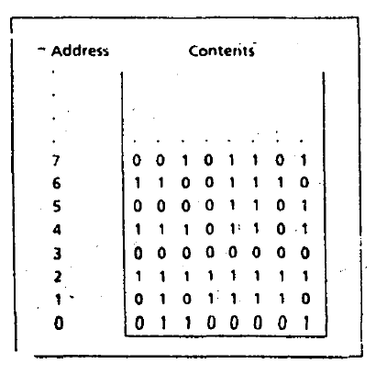
Address Vs Contents

Slide 10
Memory byte addressing
Suppose a processor uses 20 bits for an address. How many memory bytes can be addressed using this processor?
A bit can have two possible values (i.e. 0 or 1)
So, in a 20-bit address, we can have 2²⁰ or 10,48,576
In computer terminology 2²⁰ = 1 Mega
Therefore, 20-bit address can be used to address 1 MB.

Slide 11
Memory Word
In a Microcomputer, Two bytes = a word
So to store a word data, IBM PC needs :
A pair of successive memory bytes
A pair of memory bytes = Memory word
The lower address of the two memory bytes is the memory address.
i.e. a memory word with address 2 is made up of address 2 and 3
A microprocessor can detect memory byte or memory word from memory location/address.

Slide 12
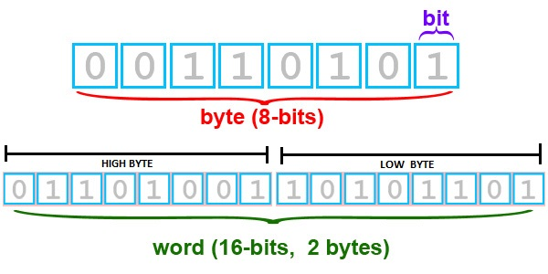
Bit Positions in byte and Word
Bit positions are numbered from Right to left
Bit 0-7 = low byte [ Lower address of word]
Bit 8-15 = high byte [ Higher address of word]

Slide 13
Memory Operations
The processor can perform two operations on memory
Read or fetch the contents from a location
Processor only gets a copy of the data
Original contents of the location are unchanged
Write or Store data at a location
The data written become the new contents
The Original/previous contents are lost

Slide 14
RAM and ROM
RAM: Random Access Memory
RAM locations can be read and written
Program instructions and data are stored
RAM memory are lost when the machine is turned off
ROM: Read Only Memory
Once initialized can’t be changed (Read Only)
Retain values unlike RAM [example]
ROM based programs are known as firmware
Responsible for loading start-up programs

Slide 15
BUSES
A processor communicates with memory and I/O devices by using signals.
Signals are travelled along set of wires or connections called buses.
There are three kinds of signals and buses
Address → Address Buses
Data → Data Buses
Control → Control Buses

Slide 16
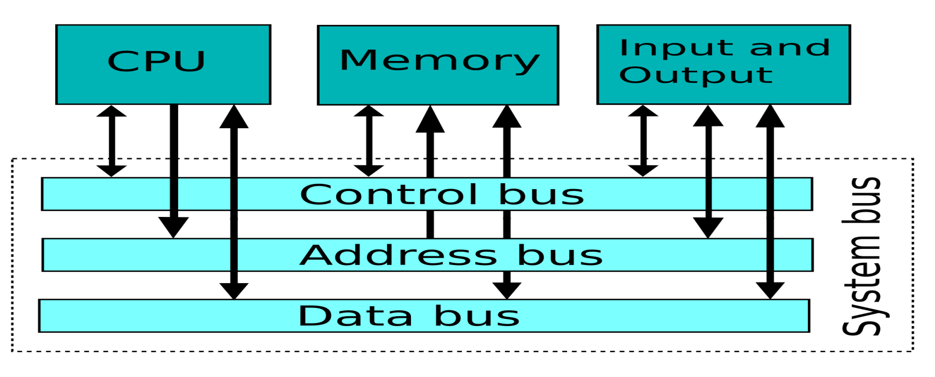
BUSES(cont’d…)
Address Bus: The CPU places the address of memory location on address bus to read the contents.
Data Bus: CPU receives the data, sent by memory circuits on the data bus.
Control Bus: CPU sends control signals on control bus perform read operation in memory.

Slide 17
CPU
CPU is the brain of computer.
CPU controls computer by executing programs (i.e. system or application).
Each instruction CPU executes, is a bit string.
Machine language: The language of 0’s and 1’s
Instructions are designed to be simple
Sequence of very basic operations
Instruction Set: The instructions performed by CPU.
The instructions set for each CPU is unique

Slide 18
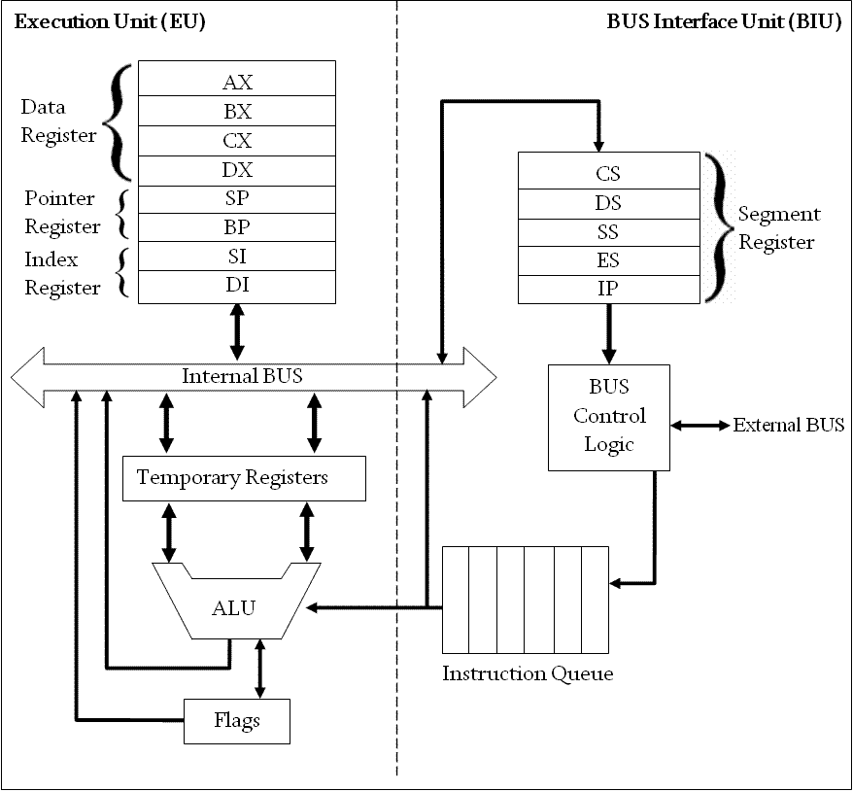
Intel 8086 Microprocessor Organization

Slide 19
Execution Unit (EU)
EU contains ALU circuits.
ALU performs arithmetic and logical operations.
Data operations are stored in registers.
A register is like memory location; however, we refer to it by name not number.
i.e. AX, BX, CX, DX, SI, DI, SP, BP
Also, EU Contains temporary registers for holding operands for the ALU and FLAGS registers.
FLAG register’s individual bits reflect the result of computation

Slide 20
Bus Interface Unit (BIU)
BIU enables communication between the EU and memory or I/O circuits.
Primarily responsible for transmitting address, data and control signals on the buses.
BIU registers are: CS,DS, ES and IP
BIU registers hold the addresses of the memory locations

Slide 21
EU and BIU
EU and BIU are connected by internal bus and they work together.
While EU executes an Instruction, BIU fetches up to six bytes of the next instruction and places instructions in instruction queue (IQ).
The overall process is called instruction prefetch and it’s purpose is to speed up the processor.
However, if EU needs to communicate with memory, BIU suspends instruction prefetch and performs required operations.

Slide 22
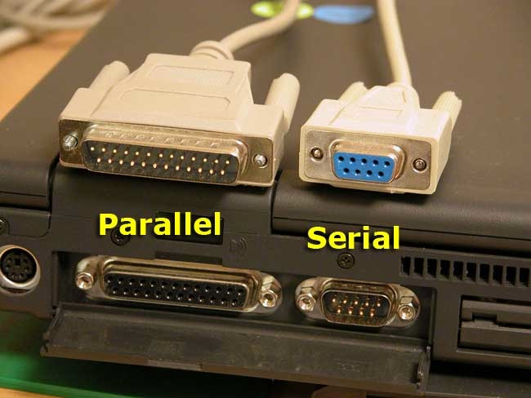
I/O Ports
I/O ports functions as transfer points between the CPU and I/O devices.
I/O devices are connected through I/O ports
Serial | Parallel
Transfers 1 bit at a time | Transfers 8 or 16 bits at a time
Serial ports tend to be slower | Requires more wiring connection
Slow devices are connected to serial port. (i.e. Keyboard) | Fast devices are connected to parallel port. (i.e. disk drive)

Slide 23
Instruction Execution
How the CPU operated?
Machine language has two parts
Opcode: Type of operation
Operands: Data to be operated on (Memory addresses are used)
The fetch- execute cycle
Fetch
Fetch an instruction from memory
Decode the instruction to determine the operation
Fetch data from memory if necessary
Execute cycle
Perform operation on the data
Store the result if needed

Slide 24
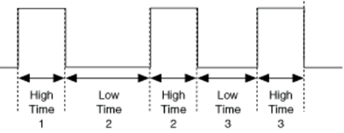
Timing
To ensure execution steps are carried out in an orderly fashion, a clock circuit controls the processor by generating a train of clock pulses
Clock Period: The time interval between two pulses.
Clock rate/speed: Number of Pulses per second.
Measured in Megahertz (MHz)
1 MHz = 1000000 (1 million) pulses per second

Slide 25
Timing Task
If you have computer with processor 2.3 GHz, How many pulses are generated per seconds from your computer?
2.3 X 1000,000,000 = 2,30,00,00,000 pulses

Slide 26
Programming Languages
Machine Language: Bit strings (i.e. 0 & 1)
Assembly language:
Symbolic names are used to represent operations, registers and memory locations(i.e. MOV AX, A)
Assembly program must be converted into machine language using assembler.
High-Level language:
Allows programmer to write program in more natural language text.
A Compiler is needed to translate high-level programs into machine language

Slide 27
Advantages
High-level
Assembly
Closer to natural language. So, algorithm conversion in easier.
Less instruction and time required than assembly language.
Programs can be executed in any machine
So close to the machine language. So programs are faster and shorter.
Reading or writing to specific memory location, I/O ports is easy.
It can be a sub program of a high-level language.
Going into more details like how computer thinks.

Slide 28
References
Assembly Language Programming and Organization of the IBM PC, Ytha Yu and Charles Marut, McGraw Hill, 1992. (ISBN: 0-07-072692-2).
https://www.researchgate.net/publication/323880534_Lecture_1_Introduction_to_Microcomputer_Microprocessor

Slide 29
Books
Assembly Language Programming and Organization of the IBM PC, Ytha Yu and Charles Marut, McGraw Hill, 1992. (ISBN: 0-07-072692-2).
Essentials of Computer Organization and Architecture, (Third Edition), Linda Null and Julia Lobur
W. Stallings, “Computer Organization and Architecture: Designing for performance”, 67h Edition, Prentice Hall of India, 2003, ISBN 81 – 203 – 2962 – 7
Computer Organization and Architecture by John P. Haynes.

